Slide 1
Highlights from the “Men & HIV Forum”: The importance of engaging men in differentiated service delivery
Anna Grimsrud
International AIDS Society
Breaking Barriers: Innovative, differentiated HIV services and self-care options for men
Tuesday, 23 July
Notes:
Convened by IAS and partners
150 delegates from communities, national networks of people living with HIV, global normative agencies, funders, implementing partners and researchers
Programme designed by a group of people
Keletso Makofane - Acknowledge patriarchy, sexism and the humanity of men where the are
Can’t afford to speak about men as if it’s a monolithic group
Discuss health systems changes or adaptations that should be considered to better reach men where they are.
Avoid the frames of “men as a problem” or “how to change men”.
Focus on interventions to reach men and improve men’s health as an end in itself, rather than interventions to reach men as a means of improving outcomes for women or addressing other social issues.
Acknowledge patriarchy, sexism and the humanity of men where the are
Can’t afford to speak about men as if it’s a monolithic group

Slide 2
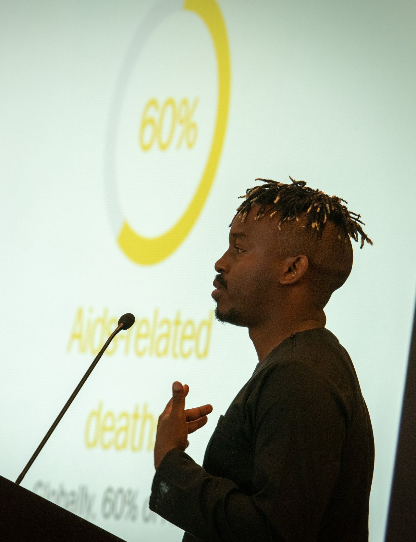
Why a “Men & HIV Forum”?
48%
60%
Living with HIV
Globally, 48% of adults living with HIV are men
Aids-related deaths
Globally, 60% of Aids-related deaths happen among men
Keletso Makofane, Harvard & IAS
2018 data, Among people 15+ years of age, http://aidsinfo.unaids.org/
Notes:
Men need our focus as they make up less than half of people living with HIV but account for 60% of HIV related mortality.

Slide 3
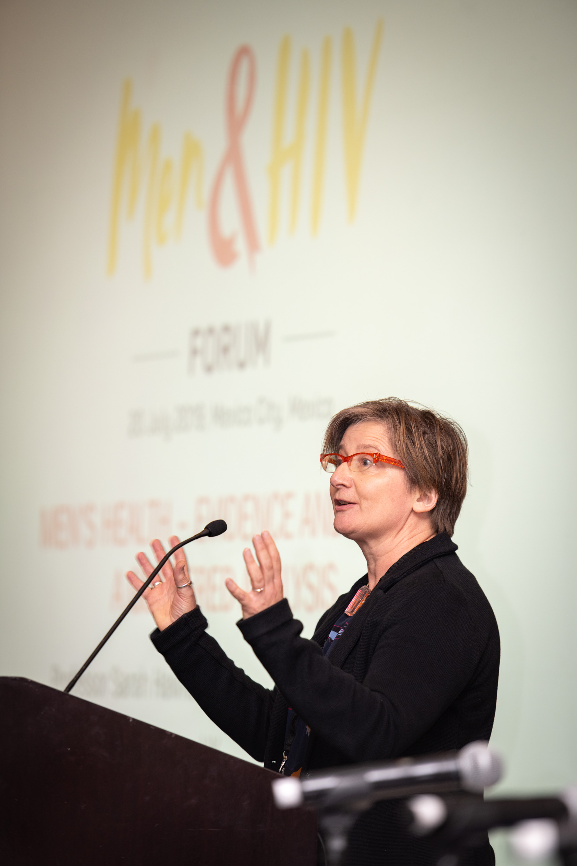
Essential change required to address men’s health
From women vs. men to inclusivity and universality
From sex-disaggregated data to gender analysis
From evidence-informed to politically informed health policies
“We need to be as politically aware as we are evidence aware.”
Sarah Hawkes, UCL
Notes:
Professor Hawke spoke about what is needed to improve men’s health highlighting that Men suffer a higher burden of disease, and die earlier than women do. Men’s life expectancy is lower in every country as compared to women.
and identified 3 key areas:
We need to stop talking about men vs women or men or women, talk about inclusivity and universality - shared risks, determinants and benefits of all of the work that we do.
Away from sex disaggregated data to a gender analysis to understand why you’re seeing these differences
Understanding that public health is a political process - driven by politics rather than evidence – we need to adjust our strategies to influencing the political paradigm.
We need to be at least as politically aware as we are evidence aware – challenge us to acknowledge who is benefiting from the current set up
We’ve had that evidence at our fingertips for decades. We have known about the differential life expectancies since the 17th century. This is not a new dataset.
“evidence is the not basis on which policy is made’ What
If we want to change the status quo, if we now want HIV programming to be inclusive and universal and have men and women on the agenda, we need to stop about thinking we need better evidence. And more that this is a political decision.”

Slide 4
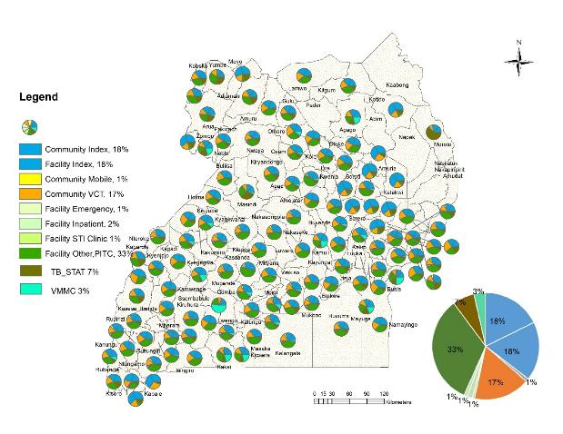
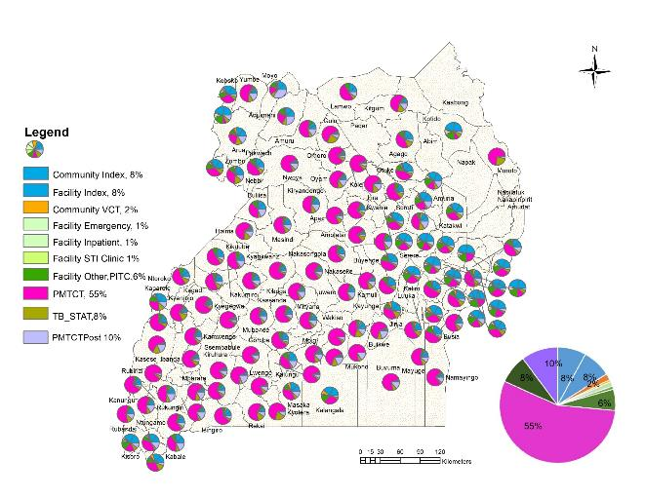
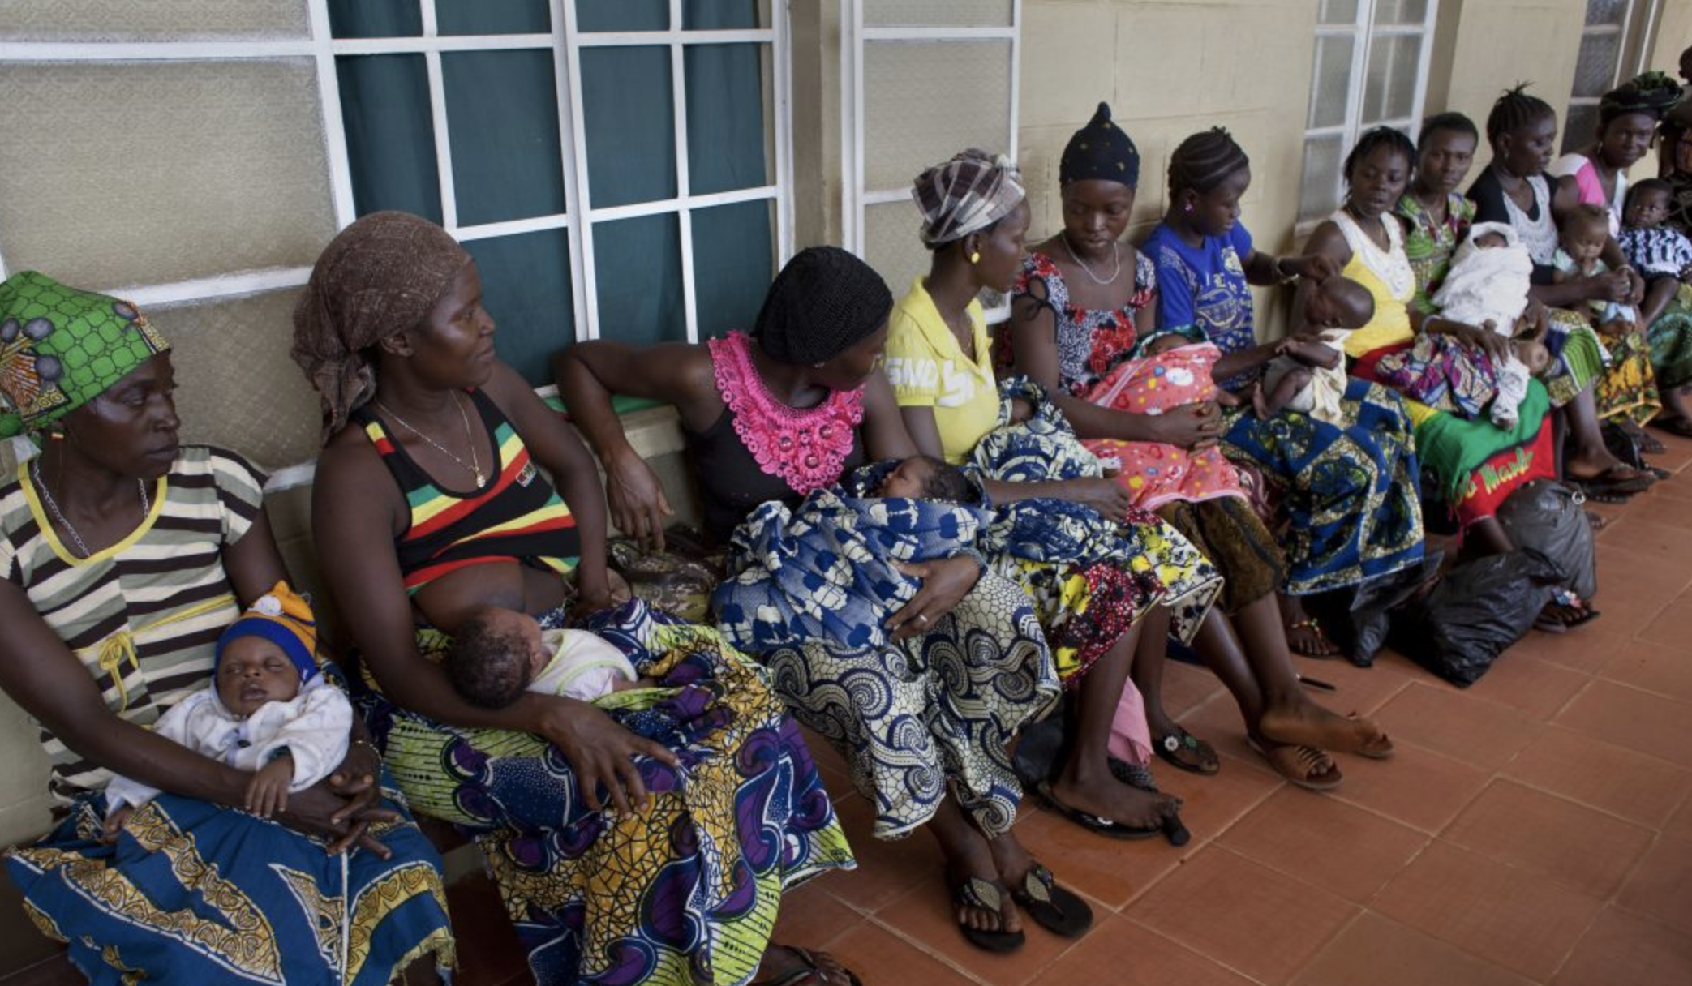
Gendered health system Where do we diagnose men?
Proportion of Males 15+ identified by modality
Proportion of Females 15+ identified by modality
33% of men identified within TB
55% of women identified within ANC
Notes:
Further PEPFAR data from Uganda showed where we diagnose men – 33% in TB services – late in their disease progressions compared with 55% of women identified through ante-natal services.
So clearly – we need to work on have other entry points, joint entry points, for men and women to access to testing. And there have been some exciting data presented here at the conference on safer conception services and other opportunities to test.

Slide 5
ART coverage (>15 years), global and regional, 2018
UNAIDS, 2019, Communities at the centre
Notes:
We reflected on the new UNIADS report that shows the disparity in ART coverage between men and women – most stark in African regions – only the region we are meeting in today shows close to equal ART coverage between men and women.

Slide 6
"We saw it in Botswana - you can get to 90-90-90 with a femininized approach, you haven’t reached the men.” Ambassador Birx
Ambassador Deborah Birx
Notes:
Ambassador Birx presented PEPFAR data and showed how you can reach 90-90-90 with a feminized approach - BUT you haven’t reached men. These are PLHIV unreached by testing treatment or viral suppression in Botswana.
And we’ve flagged this alarm before – even before thinking of the quality that 90-90-90 measures, there are ways to reach these targets that exclude specific groups of people.

Slide 7
Men’s own experiences of violence are common—and strongly associated with HIV risk behaviors
59%
39%
77%
22%
In lifetime
Witnessed an armed attack
In lifetime
Robbed at gunpoint of knifepoint
Before age 18
Beaten at home
Before age 18
Saw/heard mother being beaten
Study site: South Africa, n=962 (similar findings in Eswatini)
Pulerwitz, Population Council
Notes:
Julie Pulerwitz presented data on the men in their datasets, the partners of adolescent girls and young women
And this slide very powerfully captured a theme that ran throughout the day – that we need to acknowledge that in some of the countries with the largest HIV epidemics, here the data is from South Africa, that men’s lived experience is extremely violent. And this violence is harmful. It also flags the need to ensure that boys are included in our programming and that we need public health programming beyond HIV to improve HIV outcomes.
Shawn Malone -Many men live in an environment of chronic stress, violence, trauma and uncertainty.

Slide 8
Men want services
van Rooyen, HSRC & Wits
Notes:
Mike Nyrieda Kate Dovel – the # of health system interactions for men compared to women – most men haven’t been to clinics or hospitals since they were children – Women 5-17 times/year, men once
Sherri Lippman highlighted in work from Mpulmalanga at the beginning of their work that only 6% of clients in the clinic were men – but reported good experiences
And here, Heidi van Rooyen highlighted that in their work in KZN, the extraordinarily high uptake of health services.

Slide 9
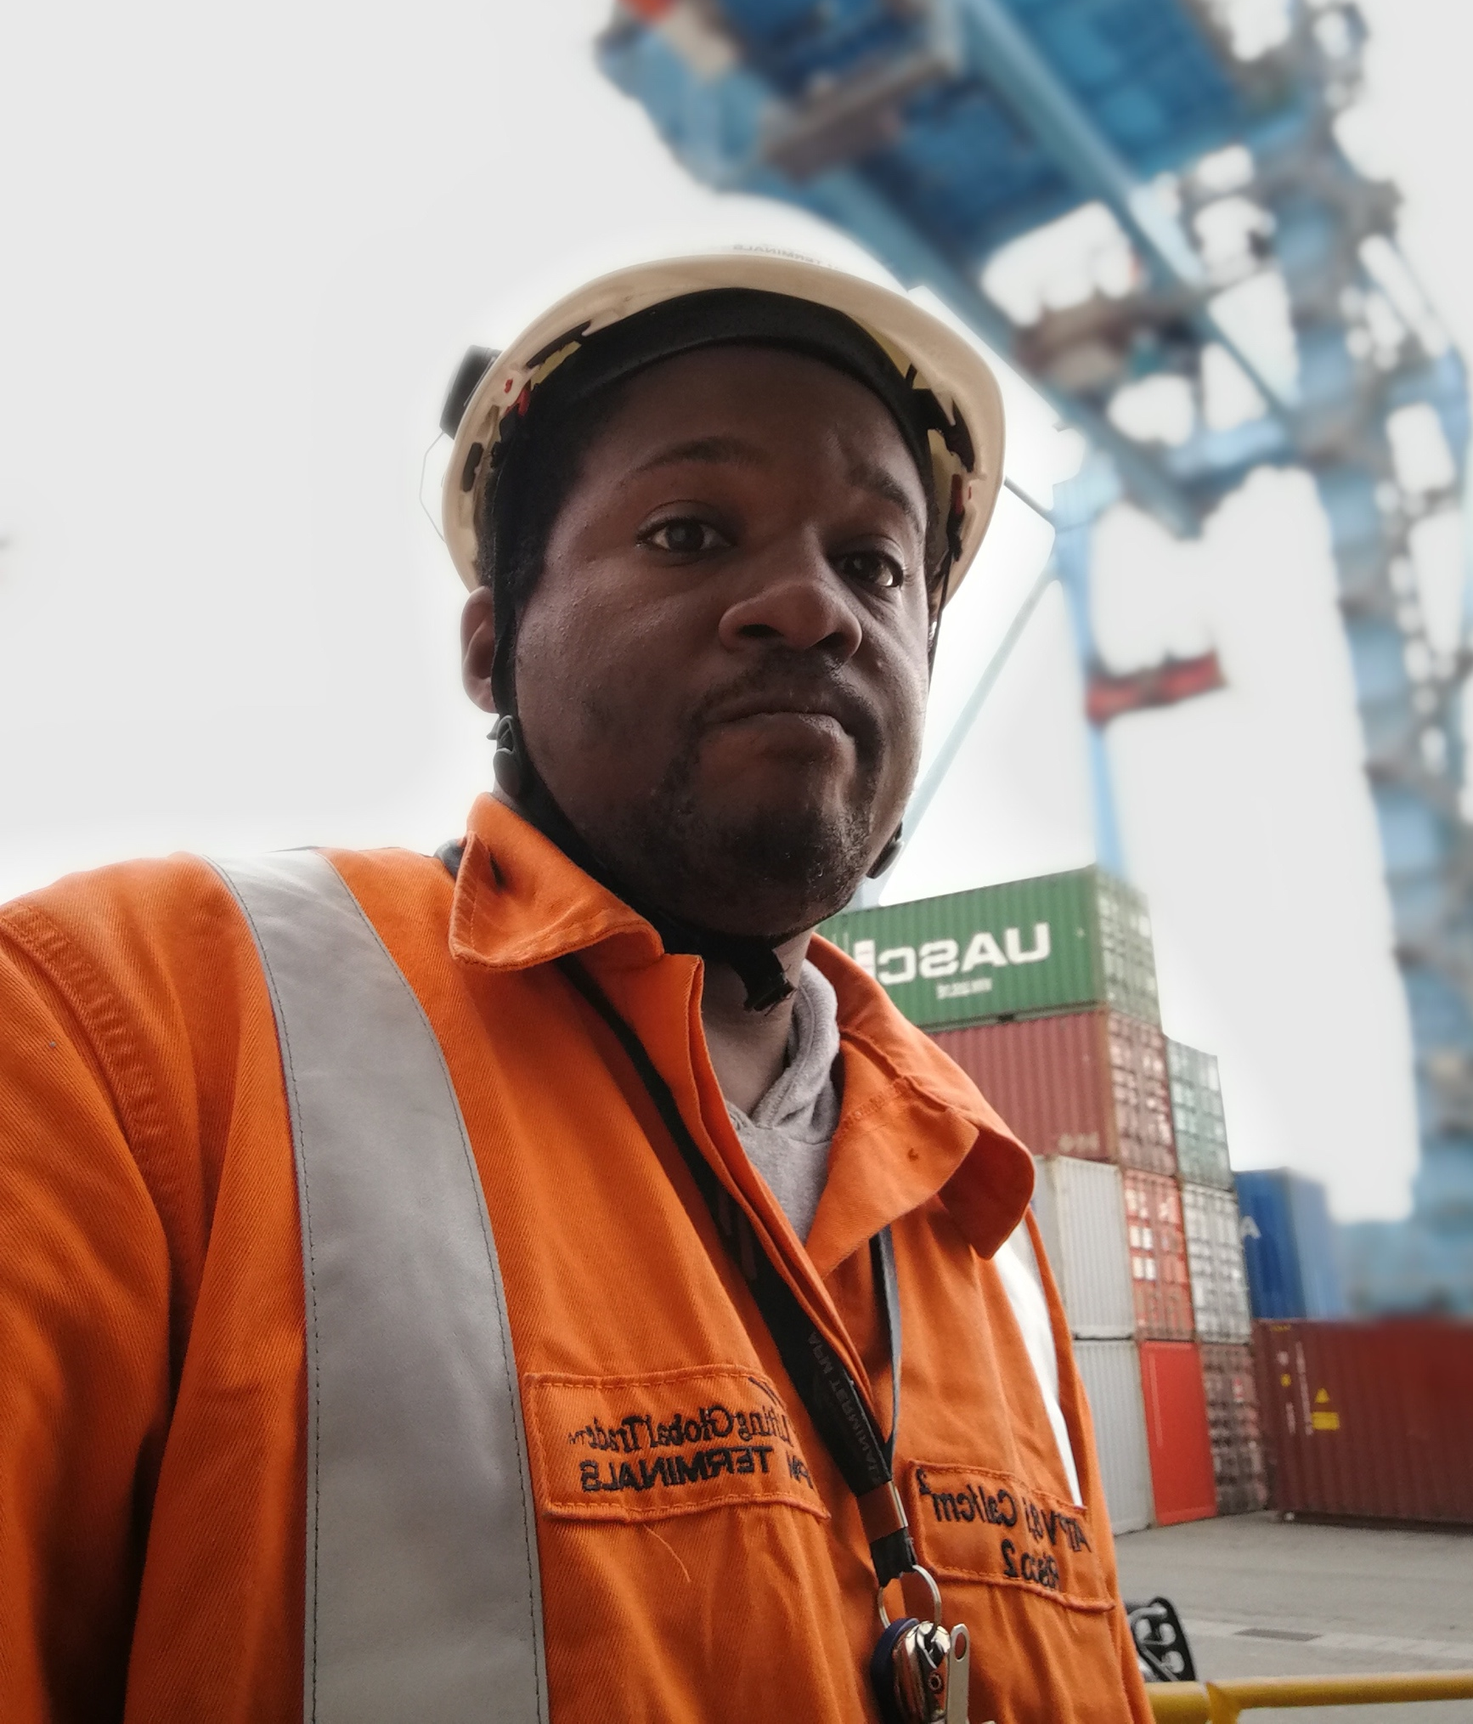
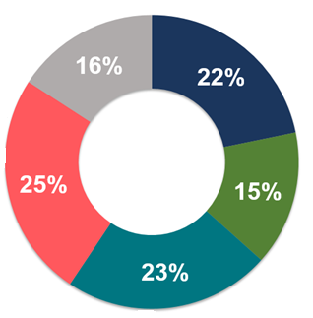
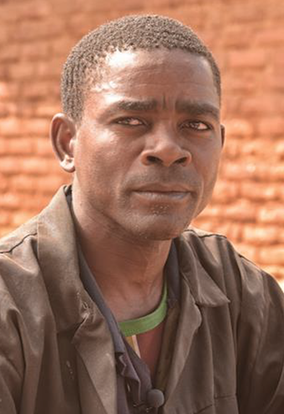
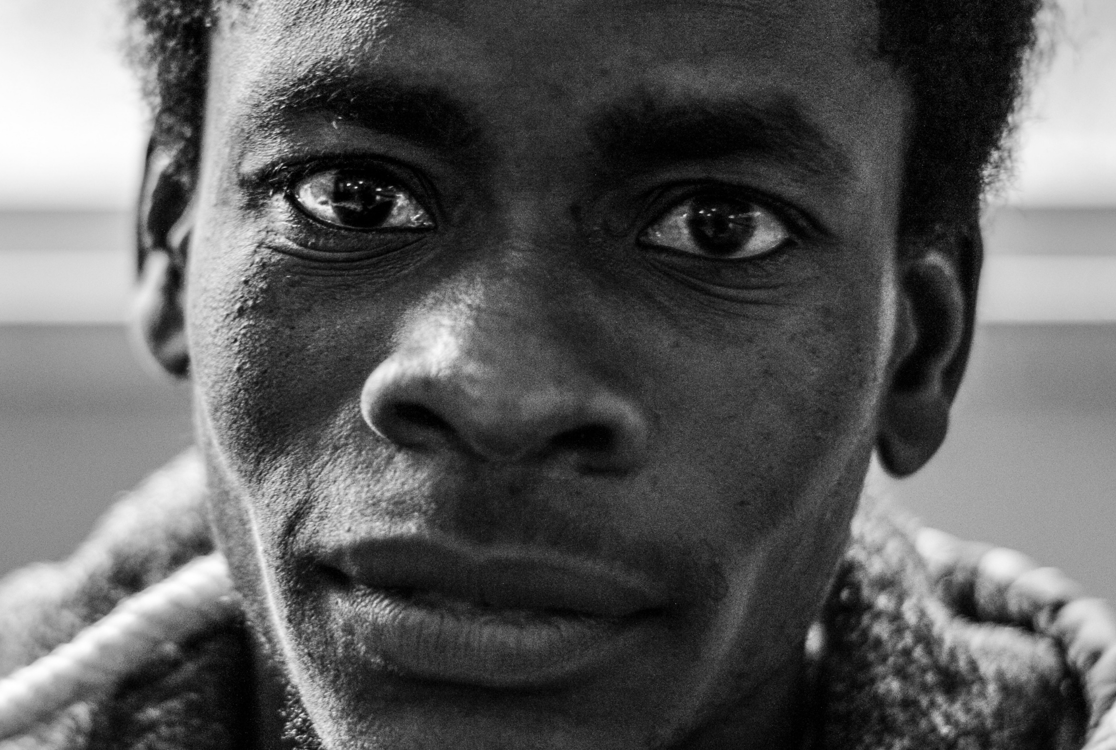
“There isn’t “the men”. There’s different men with different needs. It translates a generic response into a tailored response, meeting the clients where they are.”
Mr Blue
Mr Rose
Mr Green
Mr Grey
Malone, PSI
Mr Teal
Notes:
So how are we going to improve uptake? Well first -
The day moved on to reflect extensively on studies and experience that showed there isn’t a generic population which we can identify as men “the men”. There’s different men with different needs – many of whom are not hard to reach. Shawn Malone from PSI and their partners showed how the particularly hard to reach group of men (Mr Green) only make up 18% of the male population in South Africa. These men will need extra support and we could look to KP services for lessons and best practises.

Slide 10
To improve men’s health
Empower men in communities with information:
U=U
Clinic services
Pathway ahead
Create demand among men for health services
Adapt health services for men
Notes:
We heard from Philip Nyakwama from men against aids in Kenya that often it’s women who hold the information and men who hold the power and make the decions
U=U
Knowledge
What men can expect
Utilization of male champions

Slide 11
To improve men’s health
Service delivery for men What do they want?
WHEN | Outside of traditional service hours
WHERE | Within communities - where they are
WHO | Access to male service providers
WHAT | - HIV services within wellness health services - HIVST
Create demand among men for health services
Adapt health services for men
Notes:
The second piece of the puzzle involved how we adapt health services for men - the common building blocks that came out from country best practices and research studies are reflected here:

Slide 12
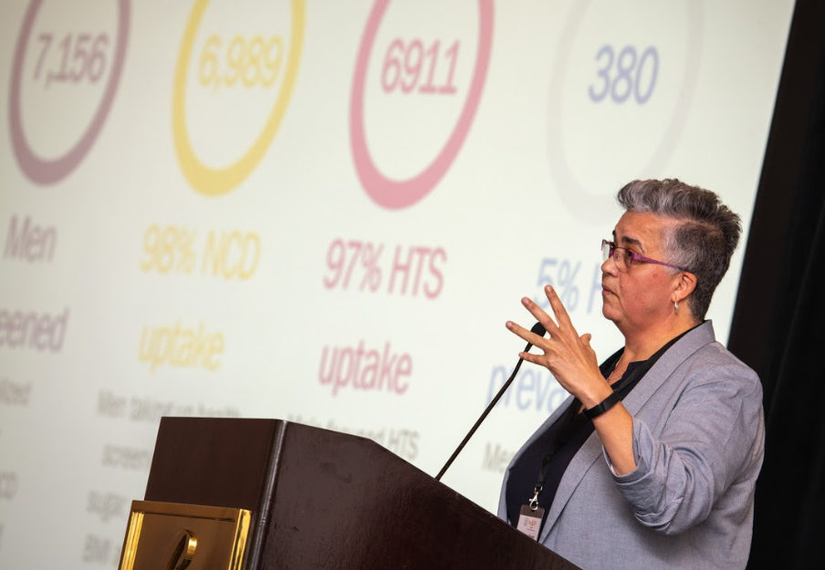
Outside of traditional service hours
Zwakala Ndoda, South Africa
<10% utilization before noon
Peak utilization (59%) after 3pm
Heidi van Rooyen, HSRC & Wits
Notes:
WHEN: Zwakala Ndoda: <10% utilization before noon, Peak utilization (59%) after 3pm
MSF, PopART and Lesotho Ministry of health men’s clinic provided extended and weekend hours – policy barrier!

Slide 13
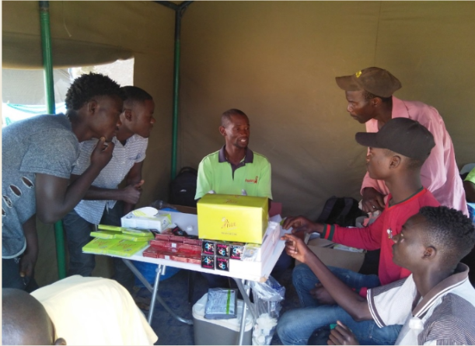
Outside of health facilities
Community hubs
Taxi ranks
Mobile services at places where men meet
PopART, MSF Eshowe, Zwakala Ndoda
PopART, Zambia
Notes:
Fewer men reach than women
1-year intervention – 23% men not contacted compared to 10% of women
Lower consent from men than women
91% of women consented to intervention compared to 83% of men Hub provided testing to 38% of men missed by home-based service delivery
But also we are expecting 6 visits to the facility in the first 6 months on treatment –and in Malawi, this equates to 40 hours – which is not going to support adherence

Slide 14
Access to male service providers
Khotla, Lesotho
“Continued training and mentoring of male health care workers on provision of male-friendly services at all facilities”
Notes:
WHO – all studies found a segment of men wanted to be serviced by male service providers - Men need to hear from other men. Cause they’re more likely to hear men.”
Some men…

Slide 15
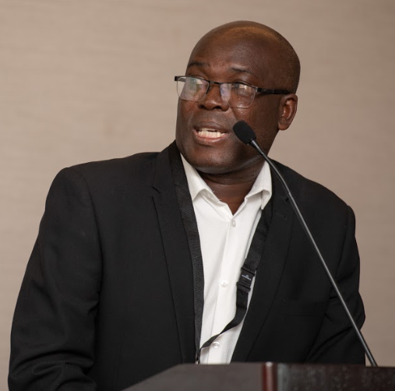
HIV services within wellness services
Intervention provided HIV testing services within broader health service as indicated by formulative work (PopART, Zambia)
“Don’t talk to us about HIV (again). Talk to us about health and wellness. Talk to us about who we are.”
Musondo Simwinga, Zambart
Notes:
WHAT: best practices found that men preferred HIV services integrated within other wellness or sexual health services
And for testing specifically valued the availability of HIVST for testing more confidentially in their own space with those they choose for support.

Slide 16
HIV self testing
Address a range of challenges and barriers
Testing and linkage trigger feelings of fear and loss.
Many men fear and resist a loss of control and personal autonomy.
Clinics can be unfamiliar, unpleasant and inconvenient.
Shawn Malone, PSI, South Africa
Mike Nyirenda, PIH, Malawi
Dr Musondo Simwinga, Zambart, Zambia
Notes:
The critical features of HIV self testing that led to increased uptake of testing for men were that HIVST can address many of the barriers and challenges that men cite as reasons for not engaging – so we need to learn about other interventions that will also address these.
They can do it whenever (When)
They can do it wherever (Where)
Who – big issue on confidentially and service providers and control

Slide 17
Key closing reflections
“We need to have sero neutral programming and U=U in each cultural context. And we need to treat people right.”
“Please focus it on the health. Not the HIV. I may be coming to your facility and you’re focused on 90-90-90. My problem as a man living with HIV is not my HIV. It may be another thing, address my other health needs.”
Linda-Gail Bekker, DTHF & IAS
Nelson Otwoma, NEPHAK
Notes:
We need to get to a point where we have equity

Slide 18
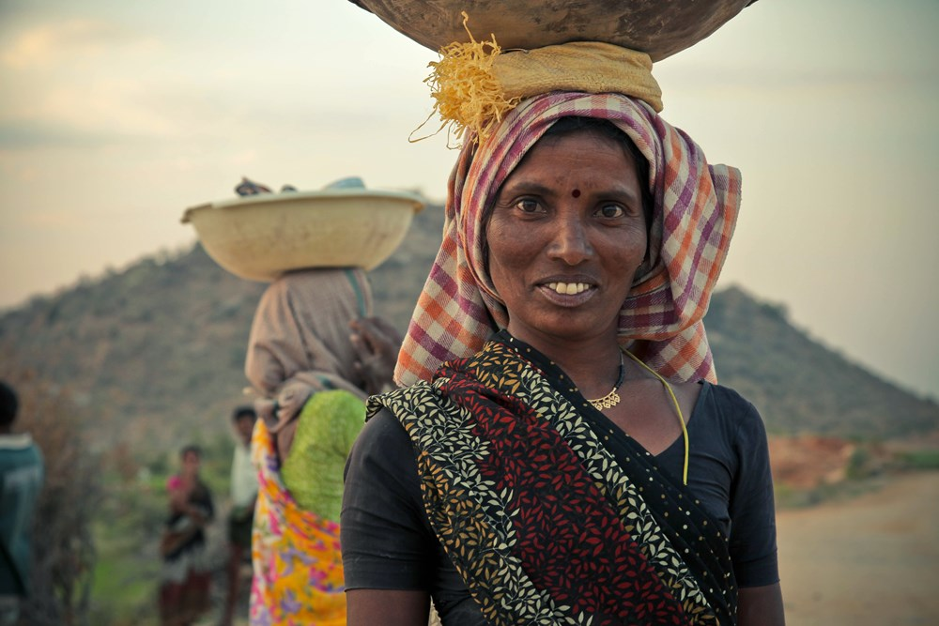
www.differentiatedservicedelivery.org
Notes:
All presentation made throughout the day are available on the DSD website – a meeting summary will be available shortly

